Slide 2
Objectives Overview
Describe the characteristics and uses of laptops, tablets, desktops, and all-in-ones
Describe the characteristics and types of servers
Differentiate among POS terminals, ATMs, and self-service kiosks
Describe cloud computing and identify its uses
Describe the characteristics and uses of smartphones, digital cameras, portable and digital media players, e-book readers, and wearable devices
See Page 108
for Detailed Objectives

Slide 3
Objectives Overview
Describe the characteristics of and ways to interact with game devices
Identify uses of embedded computers
Differentiate a port from a connector, identify various ports and connectors, and differentiate among Bluetooth, Wi-Fi, and NFC wireless device connections
Identify safeguards against hardware theft and vandalism and hardware failure
Discuss ways to prevent health-related injuries and disorders caused from technology use, and describe ways to design a workplace ergonomically
See Page 108
for Detailed Objectives

Slide 4
Computers and Mobile Devices
Types of computers and mobile devices include:
Laptops, tablets, and desktops
Servers and terminals
Smartphones, digital cameras, e-book readers, portable and digital media players and wearable devices
Game devices
Embedded computers
Page 108

Slide 5
Mobile Computers and Desktops
A mobile computer is a portable personal computer, designed so that a user easily can carry it from place to place
A personal computer (PC) is a mobile computer or desktop that can perform all of its input, processing, output, and storage activities by itself and is intended to be used by one person at a time
Page 108

Slide 6
Mobile Computers and Desktops
Page 109
Figure 3-1

Slide 7
Mobile Computers and Desktops
A laptop, also called a notebook computer, is a thin, lightweight mobile computer with a screen in its lid and a keyboard in its base
Page 111
Figure 3-3

Slide 8
Mobile Computers and Desktops
A tablet is a thin, lighter-weight mobile computer that has a touch screen
Page 112
Figure 3-4

Slide 9
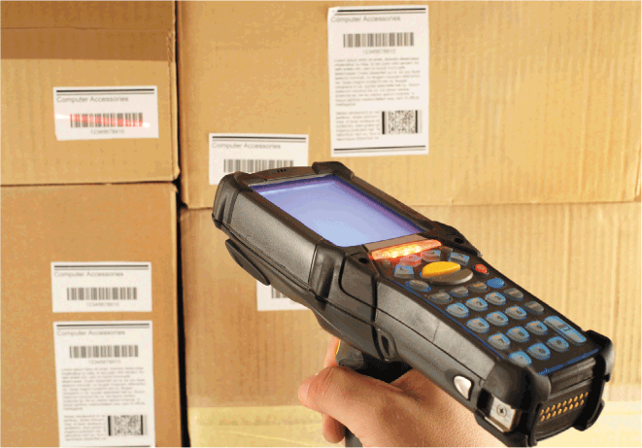
Mobile Computers and Desktops
A handheld computer is a computer small enough to fit in one hand
Page 112
Figure 3-6

Slide 10
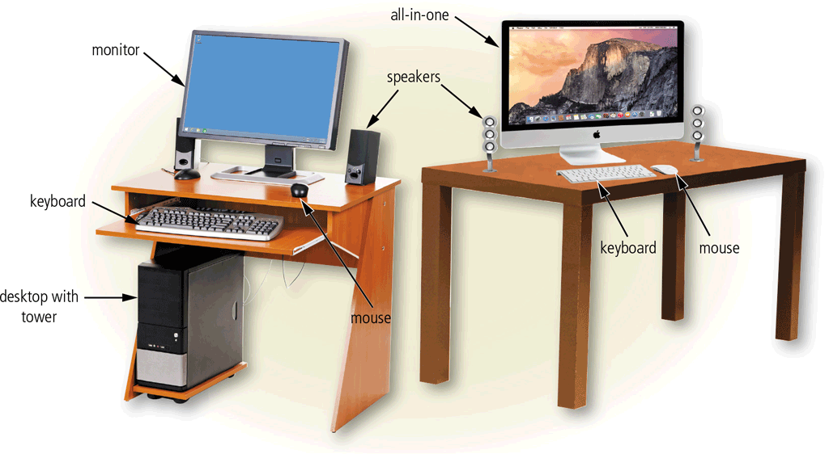
Mobile Computers and Desktops
A desktop, or desktop computer, is a personal computer designed to be in a stationary location, where all of its components fit on or under a desk or table
Page 114
Figure 3-7

Slide 11
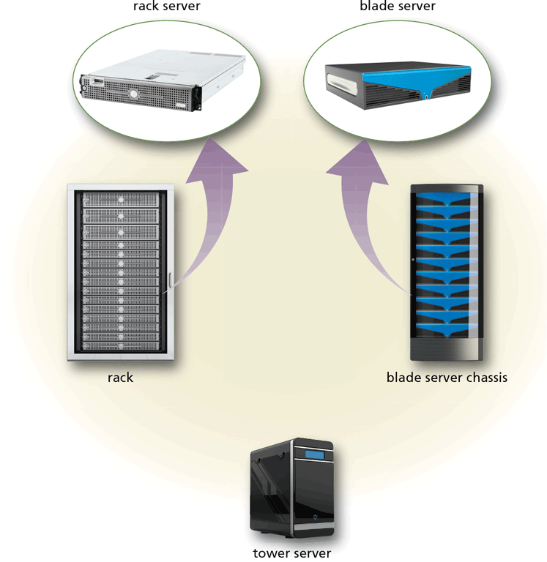
Servers
A server is a computer dedicated to providing one or more services to other computers or devices on a network
Rack server
Blade server
Tower server
Page 116
Figure 3-8

Slide 12
Servers
Page 116
Table 3-1

Slide 13
Servers
Virtualization is the practice of sharing or pooling computing resources, such as servers and storage devices
Server virtualization uses software to enable a physical server to emulate the hardware and computing capabilities of one or more servers, known as virtual servers
A server farm is a network of several servers together in a single location
Page 117

Slide 14
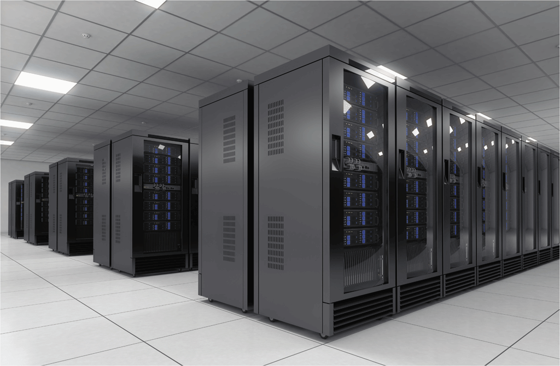
Servers
A mainframe is a large, expensive, powerful server that can handle hundreds or thousands of connected users simultaneously
Page 117
Figure 3-9

Slide 15
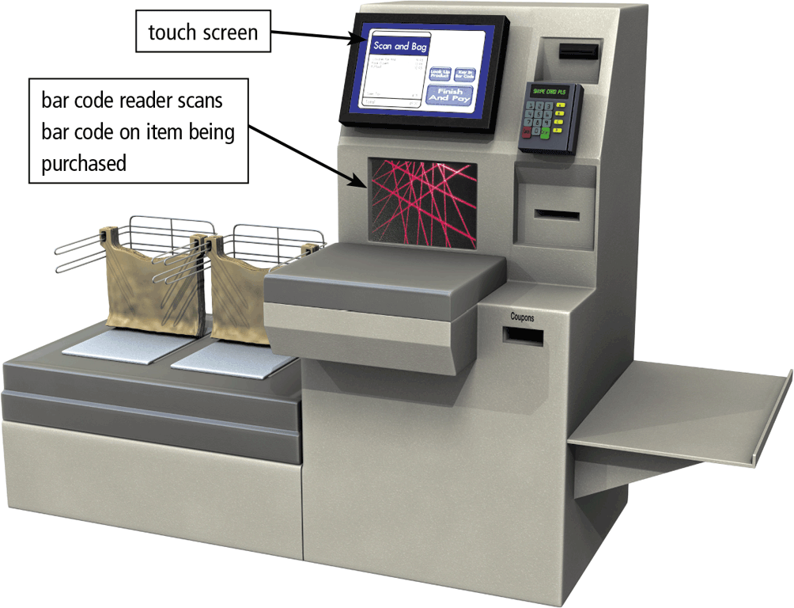
Terminals
A terminal is a computer, usually with limited processing power, that enables users to send data to and/or receive information from a server, or host computer
A thin client is a terminal that looks like a desktop but has limited capabilities and components
Most retail stores use a POS terminal to record purchases, process credit or debit cards, and update inventory
Pages 117 - 118
Figure 3-10

Slide 16
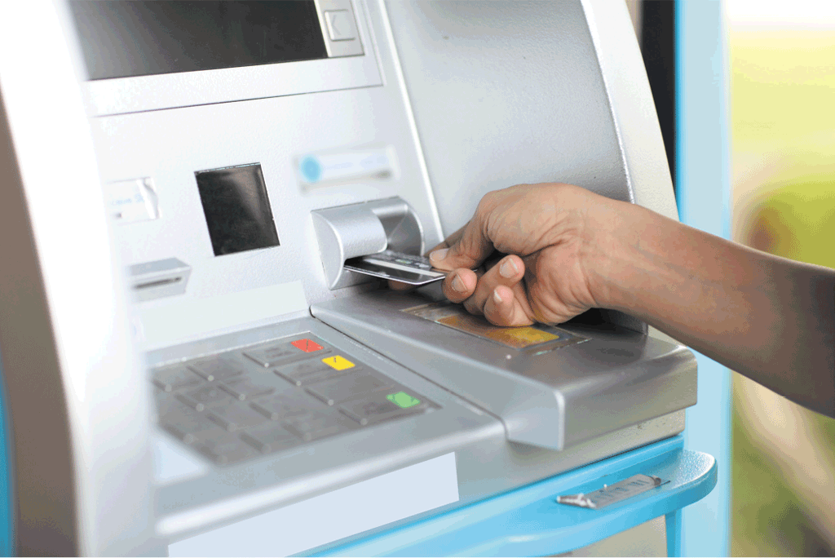
Terminals
An ATM (automated teller machine) is a self-service banking terminal that connects to a host computer through a network
Page 118
Figure 3-11

Slide 17
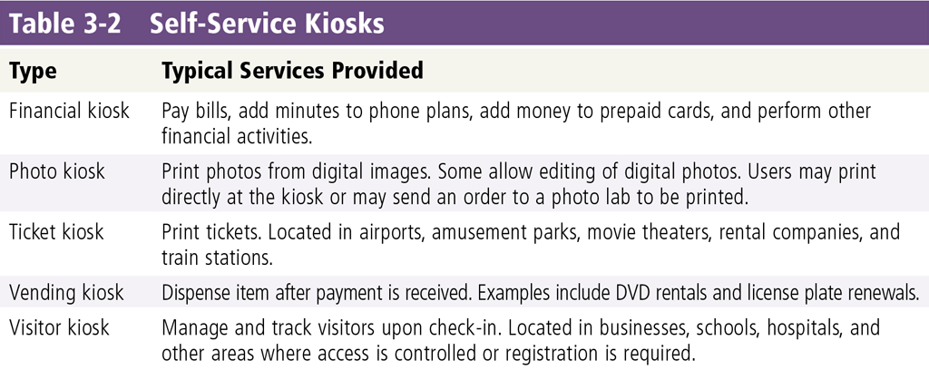
Terminals
A self-service kiosk is a freestanding terminal that usually has a touch screen for user interaction
Page 119
Table 3-2

Slide 18
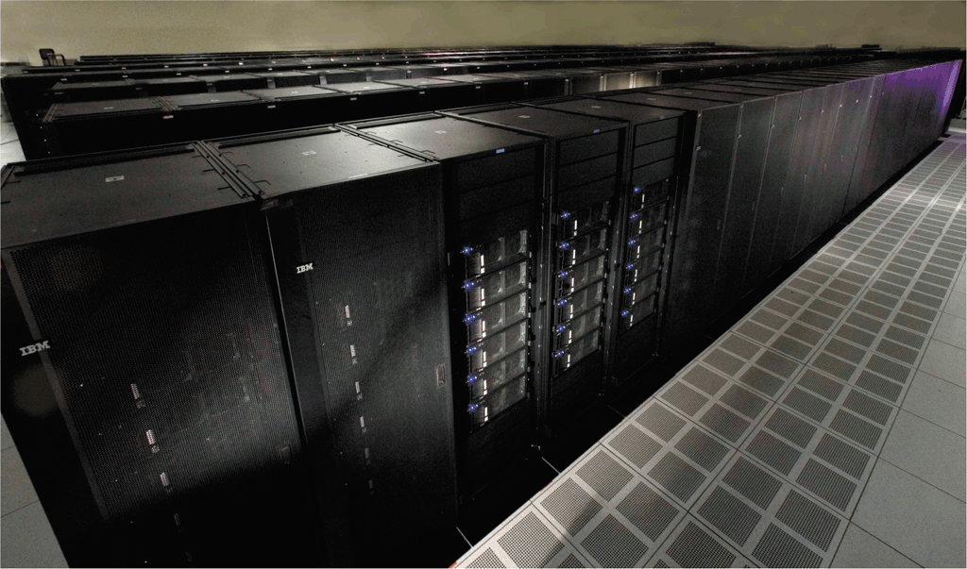
Supercomputers
A supercomputer is the fastest, most powerful computer – and the most expensive
Capable of processing many trillions of instructions in a single second
Page 120
Figure 3-13

Slide 19
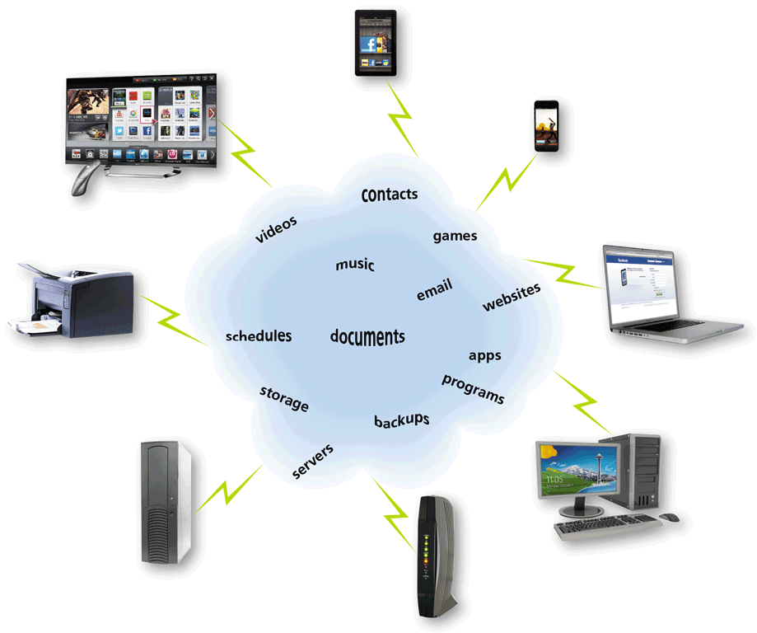
Cloud Computing
Cloud computing refers to an environment that provides resources and services accessed via the Internet
Page 121
Figure 3-14

Slide 20
Mobile Devices
A smartphone is an Internet-capable phone that usually also includes a calendar, an address book, a calculator, a notepad, games, browser, and numerous other apps
Many smartphones have touch screens. Instead of or in addition to an on-screen keyboard, some have a built-in mini keyboard on the front of the phone or a keyboard that slides in and out from behind the phone
Page 123

Slide 21
Mobile Devices
Page 123
Figure 3-15

Slide 22
Mobile Devices
Short Message Service (SMS)
Mobile to mobile
Multimedia Message Service (MMS)
Mobile to mobile
Mobile to email
Mobile to provider
Web to mobile
Mobile to email
Page 124

Slide 23
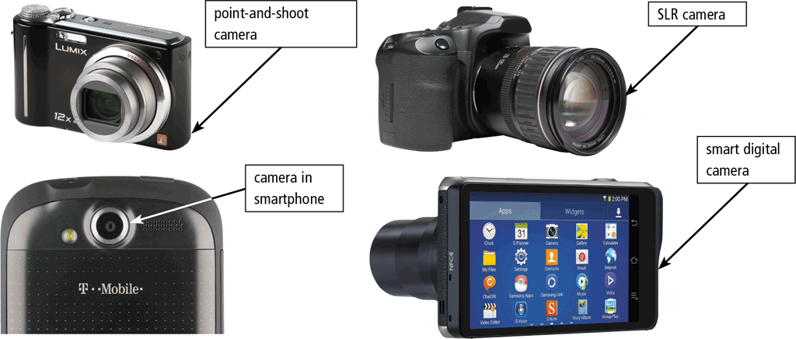
Mobile Devices
A digital camera is a mobile device that allows users to take photos and store the photographed images digitally
Smart digital camera
Point-and-shoot camera
SLR camera
Pages 125 - 126
Figure 3-16

Slide 24
Mobile Devices
Page 126
Figure 3-17

Slide 25
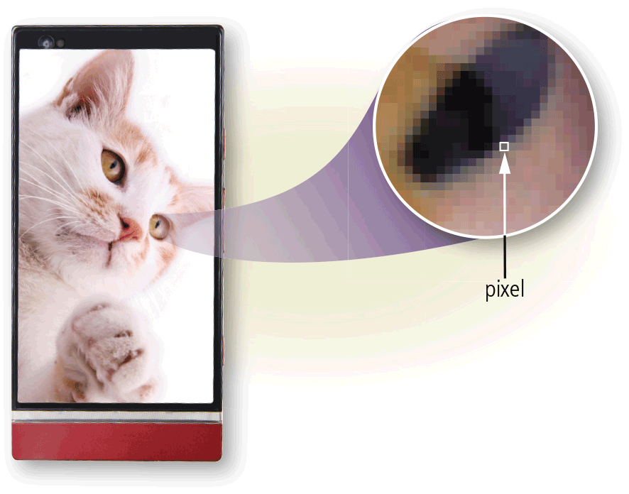
Mobile Devices
Resolution is the number of horizontal and vertical pixels in a display
Page 127
Figure 3-18

Slide 26
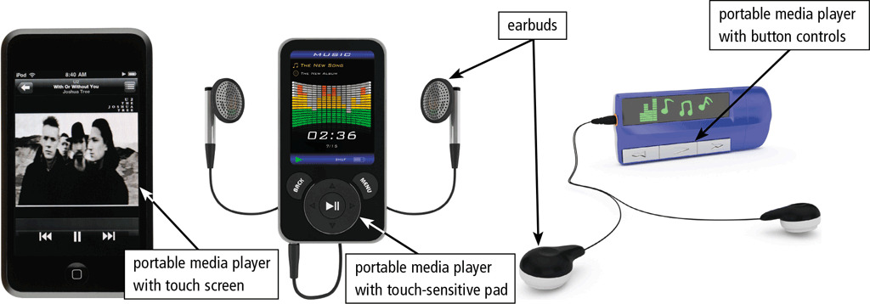
Mobile Devices
A portable media player is a mobile device on which you can store, organize, and play or view digital media
Page 127
Figure 3-19

Slide 27
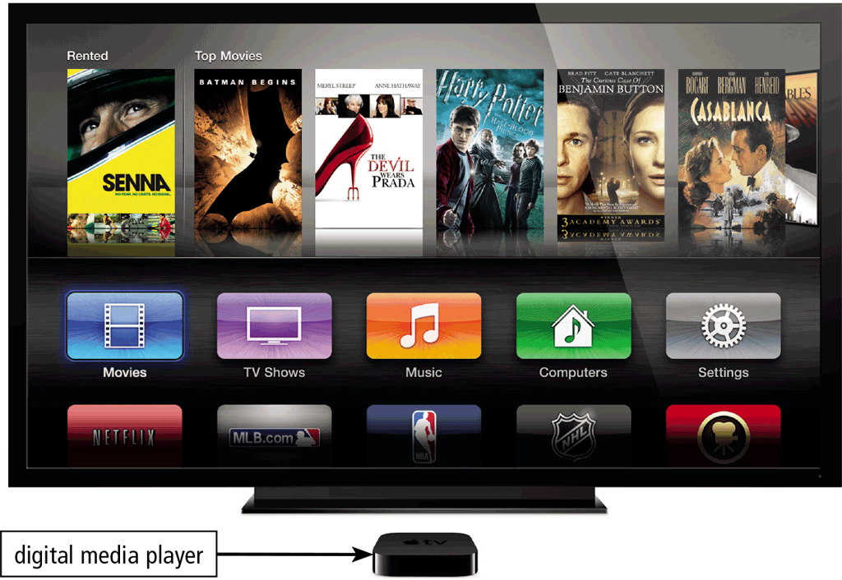
Mobile Devices
A digital media player or streaming media player is a device, typically used in a home, that streams digital media from a computer or network to a television, projector, or some other entertainment device
Page 128
Figure 3-20

Slide 28
Mobile Devices
An e-book reader (short for electronic book reader), or e-reader, is a mobile device that is used primarily for reading e-books and other digital publications
Page 129
Figure 3-21

Slide 29
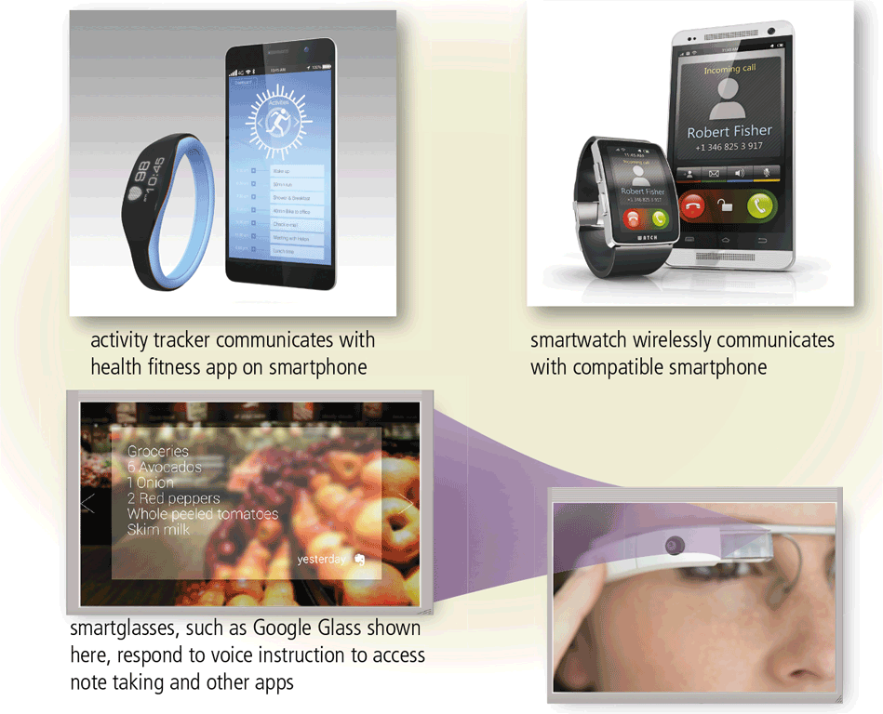
Mobile Devices
A wearable device or wearable is a small, mobile computing device designed to be worn by a consumer
Page 130
Figure 3-22

Slide 30
Game Devices
A game console is a mobile computing device designed for single-player or multiplayer video games
A handheld game device is a small mobile device that contains a screen, speakers, controls, and game console all in one unit
Game controllers include gamepads, joysticks and wheels, dance pads, and a variety of motion-sensing controllers
Page 131

Slide 31
Game Devices
Page 131
Figure 3-23

Slide 32
Embedded Computers
An embedded computer is a special-purpose computer that functions as a component in a larger product
Consumer electronics
Home automation devices
Automobiles
Process controllers and robotics
Computer devices and office machines
Page 132

Slide 33
Embedded Computers
Page 133
Figure 3-24

Slide 34
Putting It All Together
Page 134
Table 3-3

Slide 35
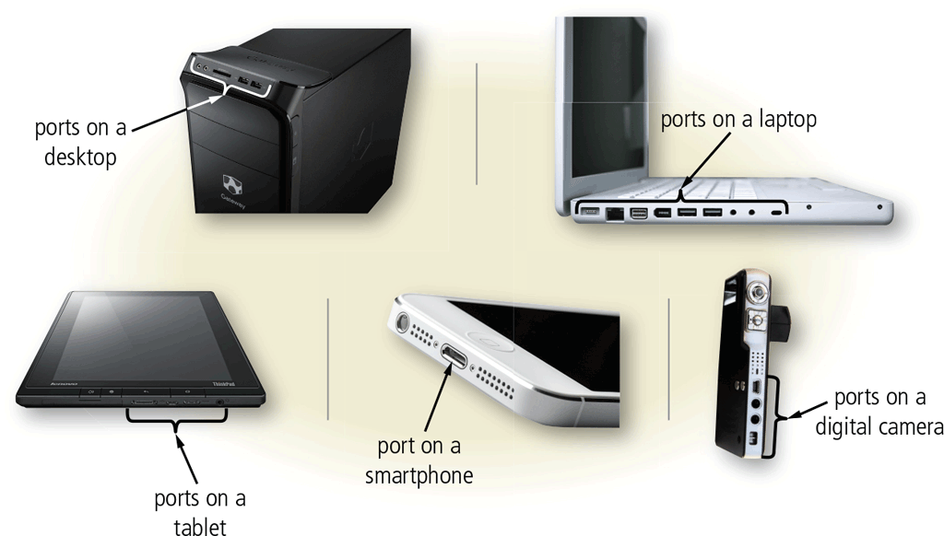
Ports and Connections
A port is the point at which a peripheral device attaches to or communicates with a computer or mobile device so that the peripheral device can send data to or receive information from the computer or mobile device
Page 135
Figure 3-25

Slide 36
Ports and Connections
A connector joins a cable to a port. A connector at one end of a cable attaches to a port on the computer or mobile device, and a connector at the other end of the cable attaches to a port on the peripheral device
Page 135

Slide 37
Ports and Connections
Page 135
Table 3-4

Slide 38
Ports and Connections
A USB port, short for universal serial bus port, can connect up to 127 different peripheral devices together with a single connector
Instead of connecting peripheral devices directly to ports on a mobile computer, some mobile users prefer the flexibility of port replicators and docking stations
Page 136

Slide 39
Ports and Connections
Page 137
Figure 3-26

Slide 40
Ports and Connections
Instead of connecting computers and mobile devices to peripheral devices with a cable, some peripheral devices use wireless communications technologies
Bluetooth
Wi-Fi
NFC
Pages 137 - 138

Slide 41
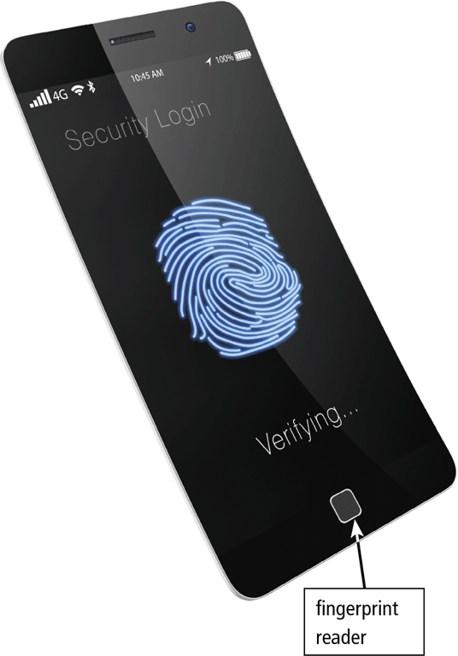
Protecting Hardware
To help reduce the chances of theft, companies and schools use a variety of security measures
Physical access controls
Alarm system
Physical security devices
Security or device-tracking app
Require identification
Page 139
Figure 3-27

Slide 42
Protecting Hardware
Hardware can fail for a variety of reasons: aging hardware; random events such as electrical power problems; and even errors in programs or apps
Undervoltage
Overvoltage or power surge
Pages 139 - 140

Slide 43
Protecting Hardware
A surge protector, also called a surge suppressor, uses electrical components to provide a stable current flow and minimize the chances of an overvoltage reaching the computer and other electronic equipment
Page 140
Figure 3-28

Slide 44
Protecting Hardware
An uninterruptible power supply (UPS) is a device that contains surge protection circuits and one or more batteries that can provide power during a temporary or permanent loss of power
Page 141
Figure 3-29

Slide 45
Health Concerns of Using Technology
A repetitive strain injury (RSI) is an injury or disorder of the muscles, nerves, tendons, ligaments, and joints
Computer vision syndrome (CVS) is a technology-related health condition that affects eyesight
Ergonomics is an applied science devoted to incorporating comfort, efficiency, and safety into the design of items in the workplace
Technology addiction occurs when the technology consumes someone’s entire social life
Pages 142- 144

Slide 46
Health Concerns of Using Technology
Page 144
Figure 3-32

Slide 47
Summary
Characteristics of and purchasing guidelines for laptops, tablets, desktops, smartphones, digital cameras, and portable and digital media players
Servers, supercomputers, point-of-sale terminals, ATMs, self-service kiosks, e-book readers, wearable devices, game devices, embedded computers, and cloud computing
Ports and connections
Ways to protect hardware
Health concerns of using technology and preventative measures
Page 145

Slide 48
Chapter 3 Complete

